Slide 1
Project Report of Data Analytics
BY
SAMYUKTHA S R

Slide 2
Crop Production Analysis in India

Slide 3
Problem Statement
The Agriculture business domain, as a vital part of the overall supply chain, is expected to highly evolve in the upcoming years via the developments, which are taking place on the side of the Future Internet. This paper presents a novel Business-to-Business collaboration platform from the agri-food sector perspective, which aims to facilitate the collaboration of numerous stakeholders belonging to associated business domains, in an effective and flexible manner. This dataset provides a huge amount of information on crop production in India ranging from several years. Based on the Information the ultimate goal would be to predict crop production and find important insights highlighting key indicators and metrics that influence crop production. Make views and dashboards first and also make a story out of it.

Slide 4
Data Attributes
State Name
District Name
Crop Year
Season
Crop
Area
Production

Slide 5
Main KPI’s
Seasons
Area
Year
Crops

Slide 6
Tools and Techniques Used
Power Query
Data Cleaning
Data Transformation
Excel
Data Analysis
Data Aggregation using Pivot Tables
Power BI
Data Visualization
Dynamic Interactive Dashboard

Slide 7




Results
The insights shows a strong relation between Crop Production with Seasons yielding 59% of crop production in India is in Kharif Season (June-October).
Correlation between Crop Production with Year indicates that increase in the 2011 by 10% and the year 2013 by 9%.
Highest yield of crops in India are achieved from 92% of Coconut, 4% of sugarcane and 1% of Rice and Wheat respectively and follow by other crops.

Slide 8
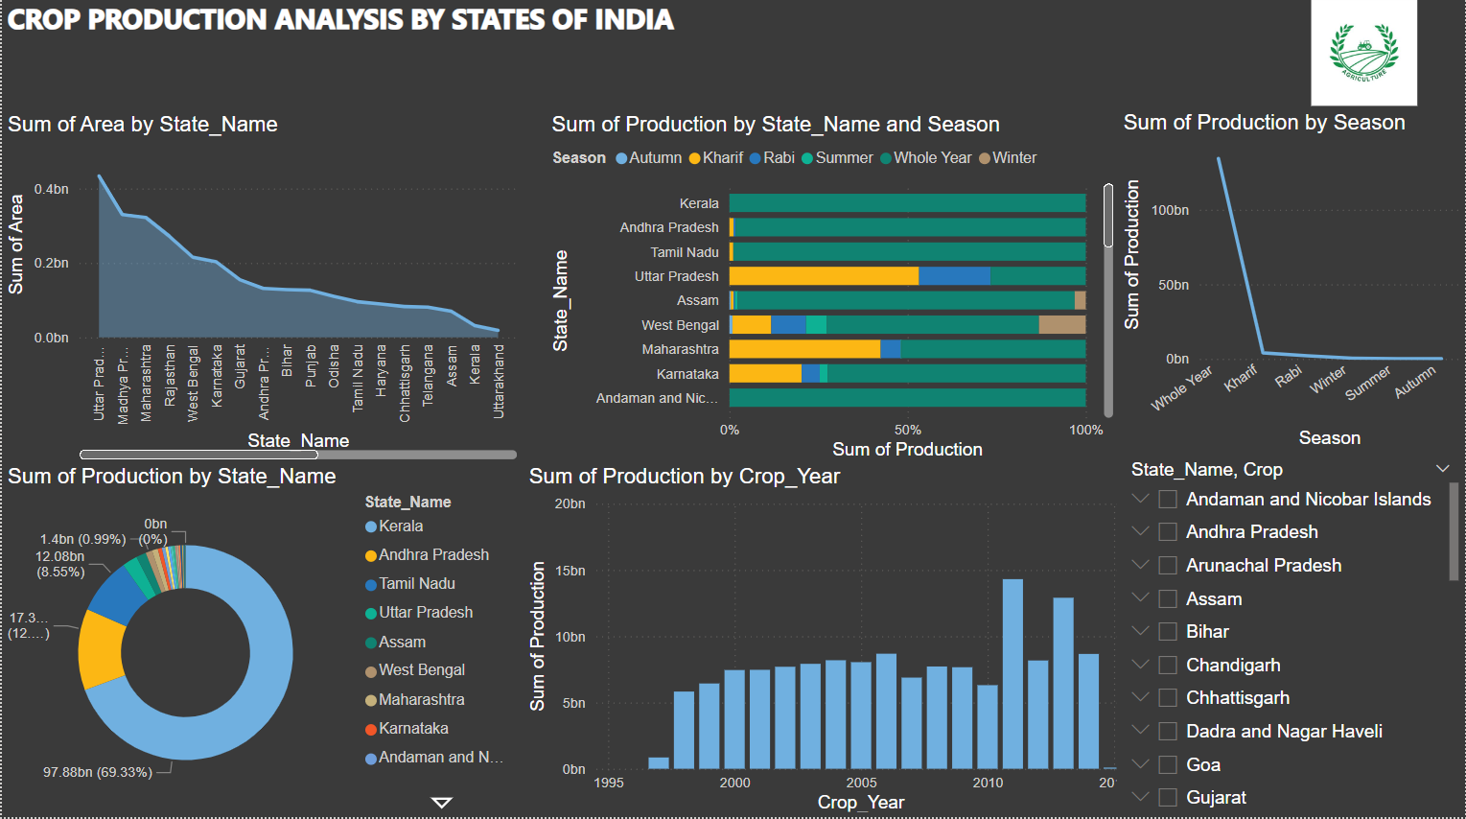
Dashboard of my Analysis (contd…)

Slide 9
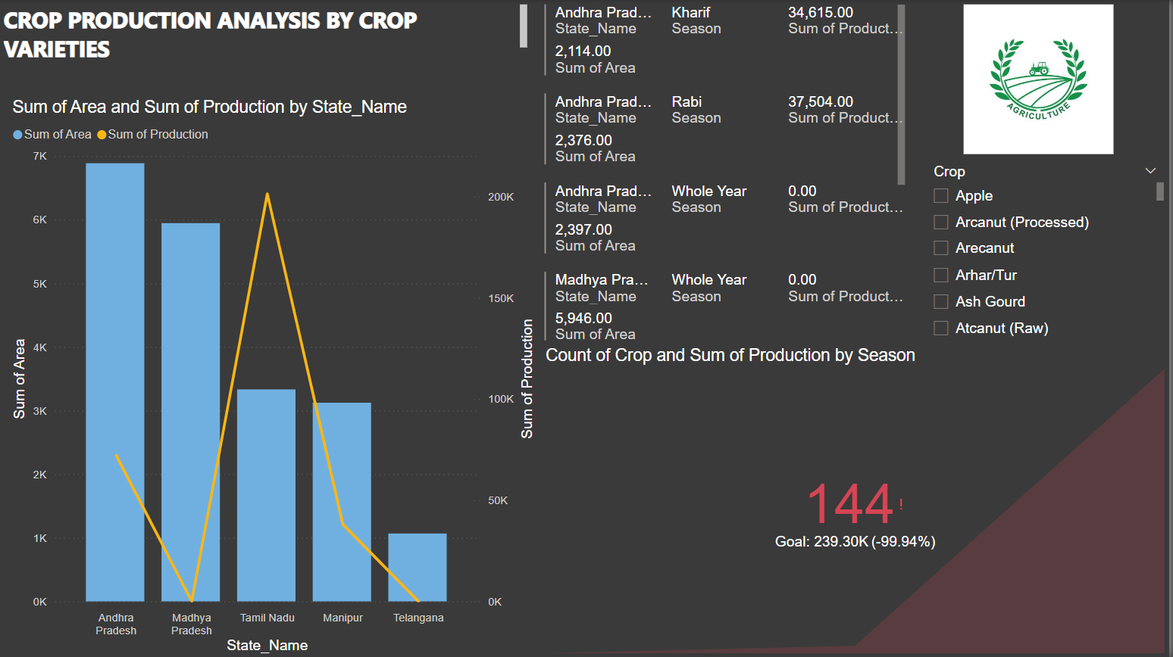
Dashboard of my Analysis (contd…)

Slide 10
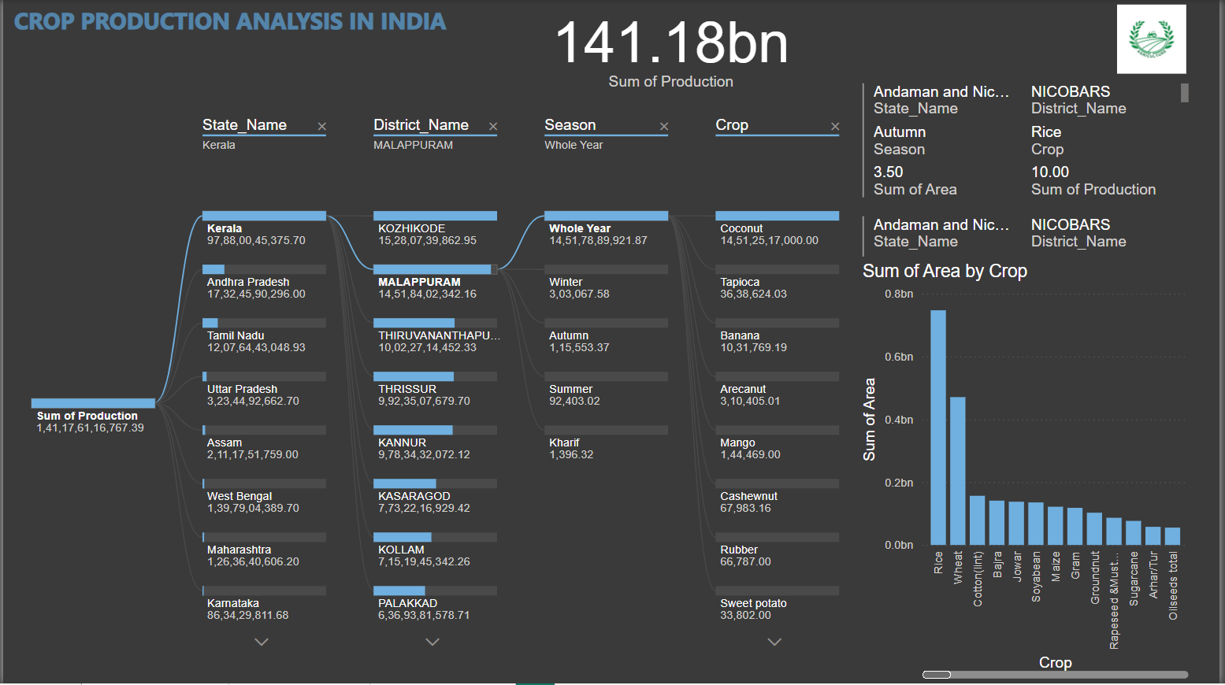
Dashboard of my Analysis

Slide 11
THANK YOU

